Slide 1
https://www.attheland.co.uk/home-education
OCR- GCSE
Food preparation and nutrition
2025- 2026
@
theland
Are you considering doing the GCSE food preparation and nutrition course as a home learner?
I have taught Food for 15 years, and my students have a track record of gaining good grades in this subject. I teach key stage 3 as well as key stage 4, and I would recommend this course for anyone who is 14+. The course is 1 year and starts in September and finishes in June.
There are 2 pieces of coursework known as NEA (non examined assessment). And 1 exam to complete.
NEA1- Food investigation (worth 15% of overall grade)
NEA2- Food preparation task (worth 35% of overall grade)
An exam- worth 50%- 1hour 30mins

Slide 2
How long does it take?
The course is 1 year and the amount of time you dedicate does depend on you. I recommend in addition to our 1 hour session, you cook at least 3 hours per week and additional course work hours will depend on the hours required by the exam board for each NEA task.
We will have 1 hour weekly session which will cover course content and coursework. Times and dates will be confirmed during the initial meeting prior to the course starting.
Our 1-2-1 session can be requested at any time for 1 hour at a time to suit ourselves.
The 3 hour lesson will take place during October and 2x 3 hour sessions in February. (subject to change due to availability and dates to be confirmed).

Slide 3
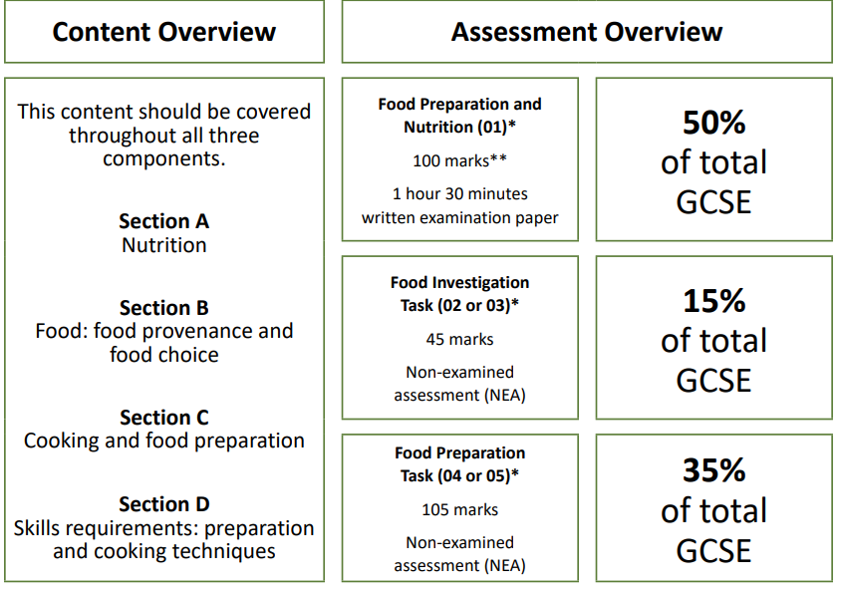

Slide 4
NEA 1- Food investigation (15%)
Choose from 2 tasks- example of previous tasks is found here… https://www.ocr.org.uk/Images/234814-unit-j309-02-and-j309-03-food-investigation-sample-assessment-material.pdf
https://www.ocr.org.uk/Images/693412-food-investigation-task-june-2024.pdf
Word limit of 1500-2000 words
2-3 Experiments of your choice based on your research
Maximum of 45 marks available, which is worth 15% of the final grade.

Slide 5
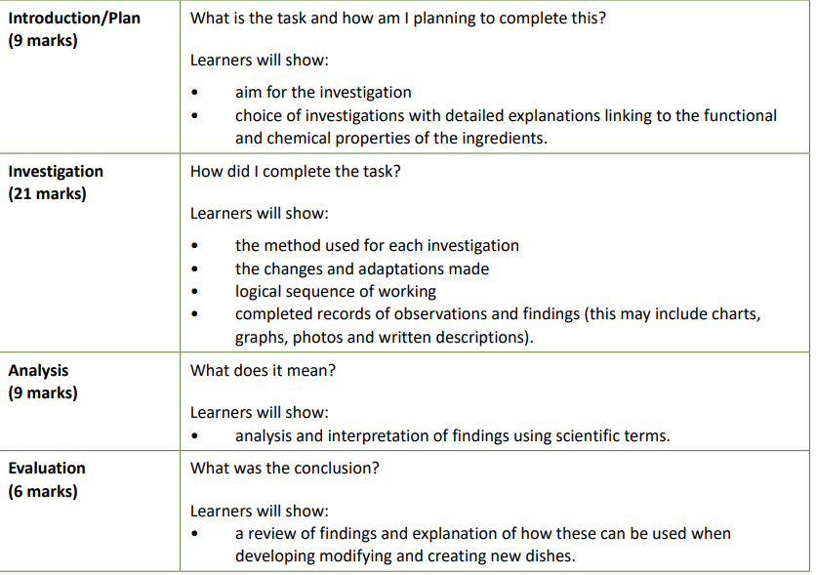
How is NEA1 marked?

Slide 6
NEA 2- Food preparation task- (35%)
Choose from 2 tasks- examples of previous task found here https://www.ocr.org.uk/Images/234815-unit-j309-04-and-j309-05-food-preparation-sample-assessment-material.pdf
https://www.ocr.org.uk/Images/698408-food-preparation-task-june-2024.pdf
20 pages of A4/ or 10 pages A3
20 hours to complete
Learners will be expected to consider and investigate the influence of the following, as appropriate: lifestyle, life stage, dietary group, culinary tradition.
Learners will select appropriate dishes demonstrating knowledge and understanding in the choice of dishes when selecting the menu. Choice of dishes will be justified in relation to ingredients, organoleptic properties, skills and techniques, cooking methods and equipment, nutritional value, cost, food provenance and seasonality.
Learners should be aware that the marks available will depend on the complexity of the skills and techniques involved for the dishes chosen. Learners will plan the task and produce a clear sequence of work to include food safety and quality points

Slide 7
Exam- (50%)- 1hr 30mins
How to apply…
Please note that the Exam Assessment is an ADDITIONAL COST which must be booked & paid for directly through Tutor & Exam.
We are not involved in the booking of the exam or the access arrangements you MUST work directly with Tutors & Exams, their booking system for the 25/26 exams
https://www.tutorsandexams.uk/contact-us/
https://www.tutorsandexams.uk/fees-and-awarding-body/
The Food Preparation and Nutrition Exam, will be held at a Tutors and Exams Assessment Centre in June 2026. It can be booked on their site by following their instructions below:
  When booking the exam, students need to click 'yes' in the field to indicate they are Registered with a Learning Partner.
  Learning Partners are listed in alphabetical order and students should select ‘@theland'. Students will need to add the code ‘---------' into the Learning Partner Student Ref.

Slide 8
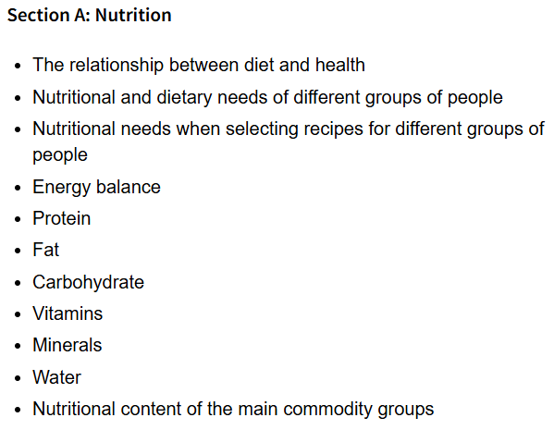
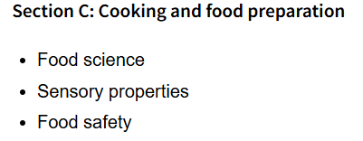
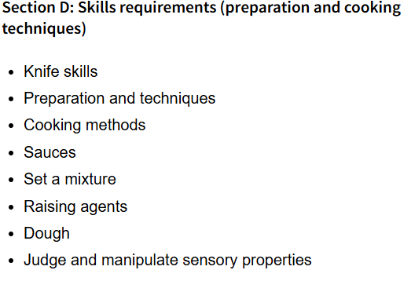
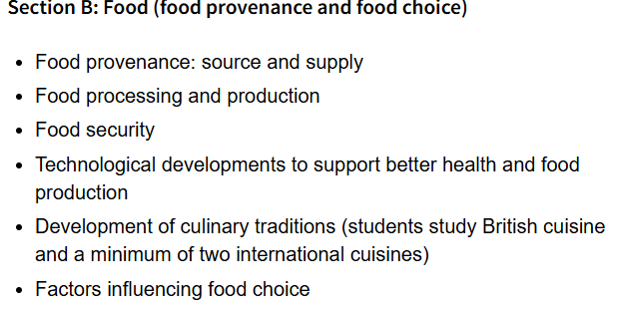
What does the course cover in preparation for the exam and coursework?

Slide 9
Recipes and skills we will cover
These can be found in our recipe book on the website https://www.attheland.co.uk/home-education
We may add more recipes if you would like to explore any skills further, but this menu covers all of the required learning skills.
Cottage pie
Choux pastry / eclairs
Filleting a fish/ fish pie or fish fingers
Portioning a chicken
Victoria sponge
Puff pastry pie or sausage rolls
Lasagne/ pasta making
Swiss roll
Quiche
Pizza and bread making
Chips and Mayonnaise
Bean or beef burger
Fajitas
Lemon Merigue
Vineese whirls
Vegan chocolate brownie
Mango and Passion Fruit Pavlova, Salted Caramel Sauce and Caramel Shards
What equipment will I need?
Here is a list of kitchen equipment we would advise you have available, but we can find alternatives if we need to!
Knives
Stick Blender
Cup Cake Trays
Baking Trays
Microwave
Weighing Scales
Icing Bag and Nozzle
Baking Dish
Rolling Pin
Deep Roasting Tray
Measuring Spoons
Sauce Pans
Frying Pans
Electric Whisk
Fish Slice
Tongs
Potato Peeler
Oven proof dish
Pastry tin

Slide 10
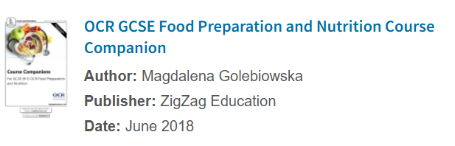
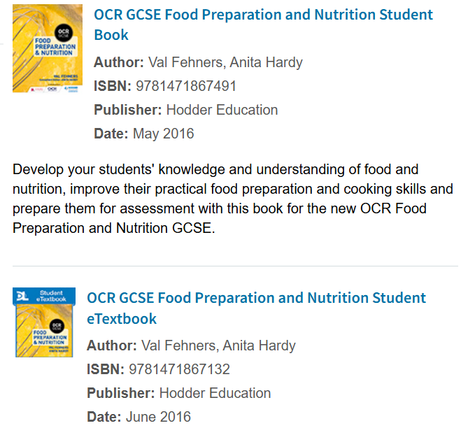
What books would help me?
https://www.ocr.org.uk/qualifications/gcse/food-preparation-and-nutrition-j309-from-2016/textbooks/

Slide 11
Costs, Timings and Location
Cost: £500
This includes 27 * 1 Hour Online Sessions, 1 * Online 1-1 and 3 * 3 Hour In House Sessions.
Plus weekly coursework and marking, and the marking of 2 Assessments which form part of the GCSE
Numbers are limited to 10 students on a first-come first first-served basis.
3 x 3 hour practical sessions will take place at Heart of England School- Gypsy lane, Balsall common, CV7 7FW

Slide 12
More information…
Check out the course specification here- https://www.ocr.org.uk/Images/234806-specification-accredited-gcse-food-preparation-and-nutrition-j309.pdf
Contact us: Laura Carroll
07969049854
Laura.jayne8888@googlemail.com
https://www.attheland.co.uk/home-education
Carrolls’ Equestrian, Eaves Green Lane, Meriden, CV7 7JL

